Slide 1
Going Deeper in Facial Expression Recognition using Deep Neural Networks(Mollahosseini et al.)
Course Title: Neural Networks and Fuzzy Logic
Supervisor : Dr. Surekha Bhanot Course No.: BITS F312 Submitted by: Akshay Goel, ID-2014B4A70587P
Aditya Mukherjee, ID-2014B5A70571P
Amitojdeep Singh, ID-2014B3A70615P

Slide 2
Division
Introduction & Preprocessing : Akshay Goel
Model Architecture : Aditya Mukherjee
Results & Improvisation: Amitojdeep Singh

Slide 3
Introduction
Facial Expression Recognition
A human-computer interaction system for an automatic face recognition has attracted increasing attention in recent times.
However, automated facial expression recognition has remained a challenging and interesting problem.
Mainly because traditional methods like bayesian classifiers, support vector machines lack generalizability when applied to unseen images and those applied to wild settings.
Akshay Goel

Slide 4
We studied an architecture which is based on deep neural networks.
It takes as input registered facial images and classifies them into either of six basic or neutral expression.
It consists of two convolutional layers each followed by max pooling and then three inception layers.
We conducted experiment on FER2013 dataset.
Akshay Goel

Slide 5
Algorithms for automated FER usually involve three main steps-
1.Registration:
Faces are first located in the image using some set of landmark points during “face detection”. These detected faces are then geometrically normalized to match some template image.
2.Feature extraction:
A numerical feature vector is generated from the resulting registered image. These features can be geometric appearance features such as pixel intensities,Gabor filters etc. We use CNN filters as features.
3.Classification:
The algorithm attempts to classify the given face as portraying one of the six basic emotions using machine learning techniques.
Akshay Goel

Slide 6
Dataset : FER2013
The data consists of 35887 samples of 48x48 pixel grayscale images.
The faces have been automatically registered so that the face is more or less centered and occupies about the same amount of space in each image.
Dataset has been created by google image search API.
There are seven facial expression labels:
0=Angry, 1=Disgust, 2=Fear, 3=Happy, 4=Sad,
5=Surprise, 6=Neutral
Akshay Goel

Slide 7
Dataset : FER2013
The dataset is divided into the training, testing and validation sets in the ratio of 8:1:1
The number of images for each expression are:
Akshay Goel

Slide 8
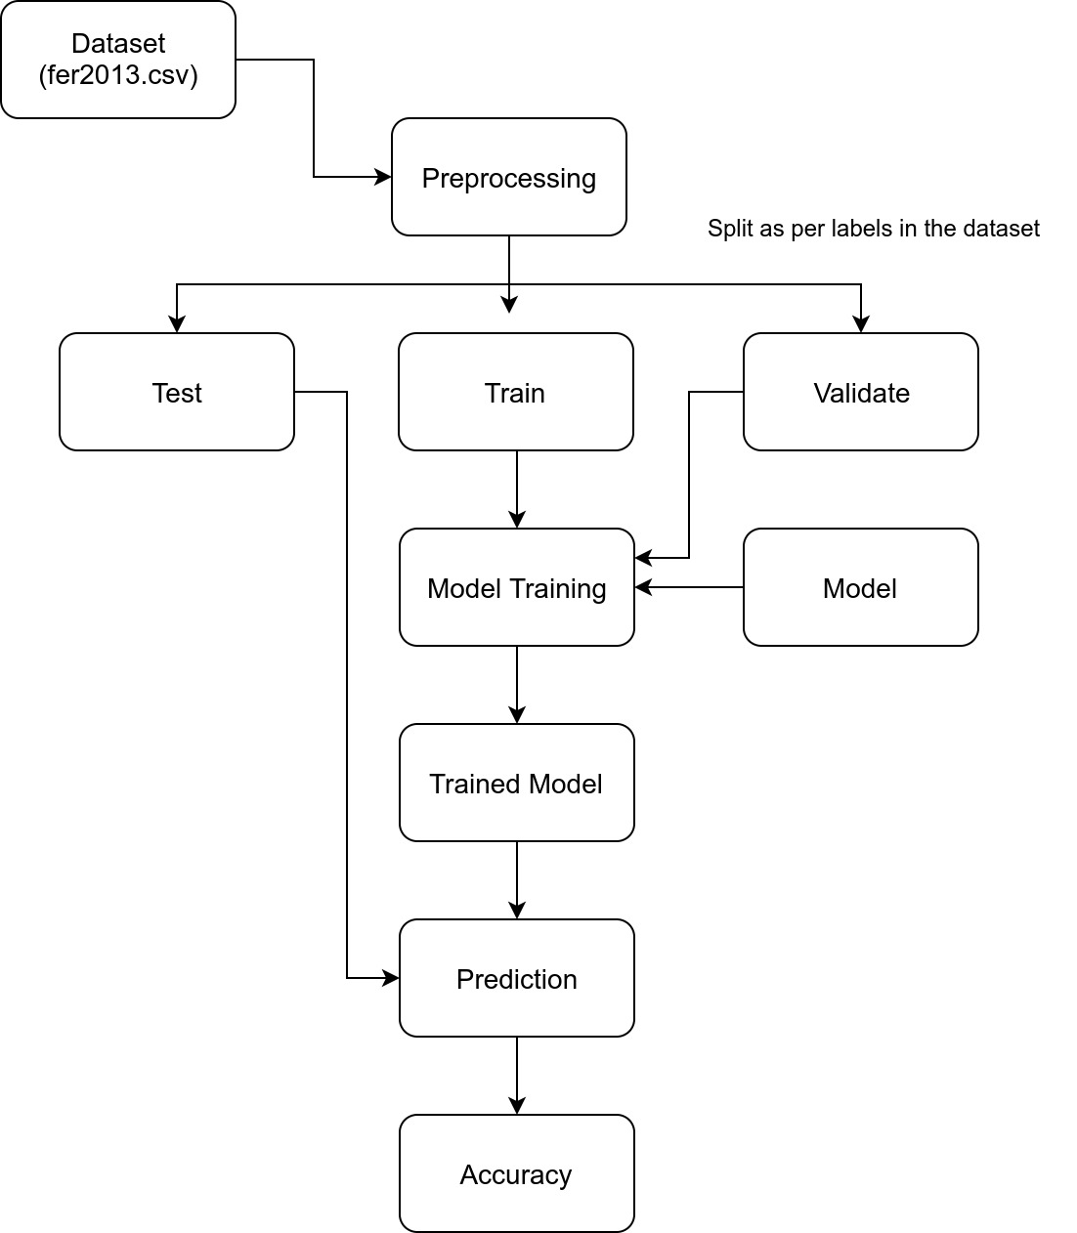
Akshay Goel

Slide 9
Preprocessing
Data Augmentation:
-We extract 5 crops of 40×40 from the four corners and the center.
- Also their horizontal flips were also included.
-A total of 10 additional images were generated.
Significant change in accuracy was observed after introducing data augmentation.
-Before about 42%
-After 55%
-But results in 10 times more running time.
Akshay Goel

Slide 10






Image Augmentation
Original Image
Center
Top Right
Top Left
Bottom Right
Bottom Left
Akshay Goel

Slide 11
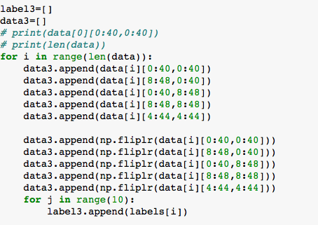
Code Snippets
Akshay Goel

Slide 12
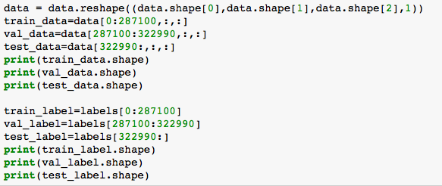
Code Snippets
Akshay Goel

Slide 13
Proposed Method
Our network consists of two elements, first our network contains of two CNN layer consists of a convolution layer by a max pooling layer.
We use ReLU as activation function at each layer except the last (where we use softmax for classification).
Following these modules, we add three ”Inception” style modules, which are made up of a 1 × 1, 3 × 3 and 5 × 5 convolution layers (Using ReLU) in parallel.
Aditya Mukherjee

Slide 14
Proposed Method
Inception layer also allows for improved recognition of local features as smaller convolutions are applied locally, while larger convolutions approximate global features.
These layers are then concatenated as output and we use two fully connected layers as the classifying layers (Also using ReLU).
Decreasing the resolution does not greatly impact the accuracy, however it vastly increases the speed of the network.
Aditya Mukherjee

Slide 15
Learning Rate Decay
The learning rates are decreased in a polynomial fashion as:
(base lr*(1 − (iter/max iter)))^0.5
where base lr = 0.01 is the base learning rate, iter is the current iteration and max iter is the maximum allowed iterations.
The optimizer used was Stochastic Gradient Descent (SGD).
We also used weight regularizers on each layers, which apply penalties on the loss function during optimization.
Aditya Mukherjee

Slide 16
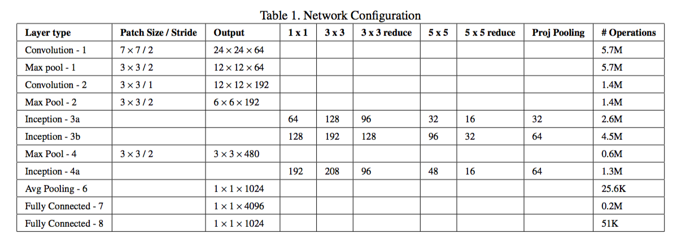
Aditya Mukherjee

Slide 17
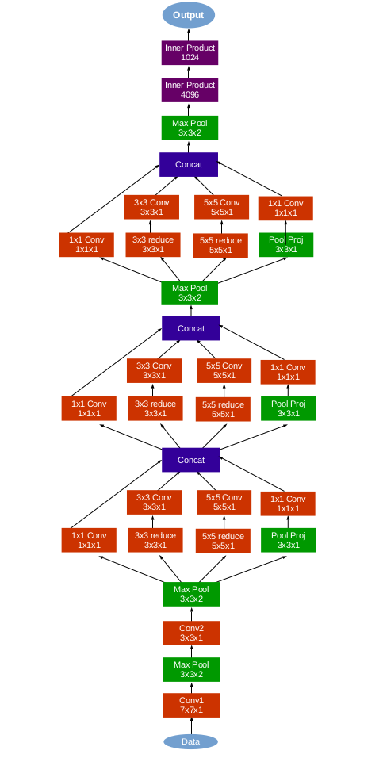
Aditya Mukherjee

Slide 18
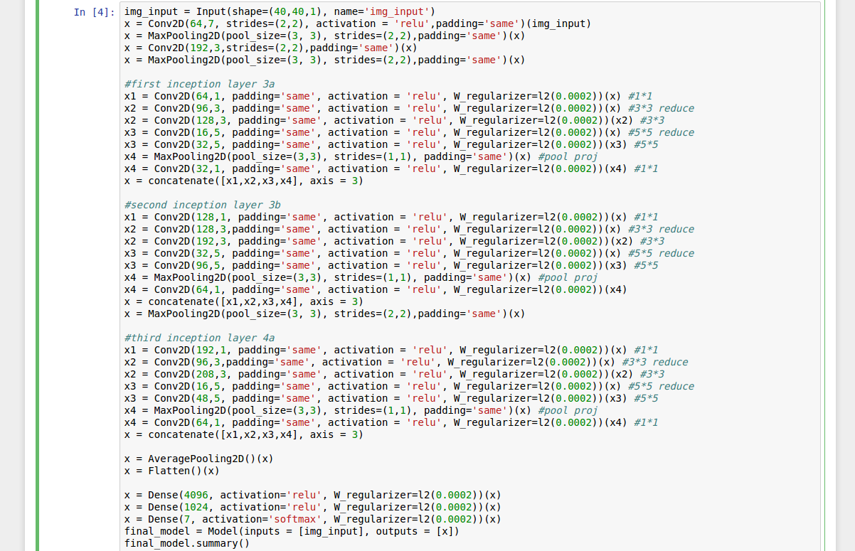
Aditya Mukherjee

Slide 19
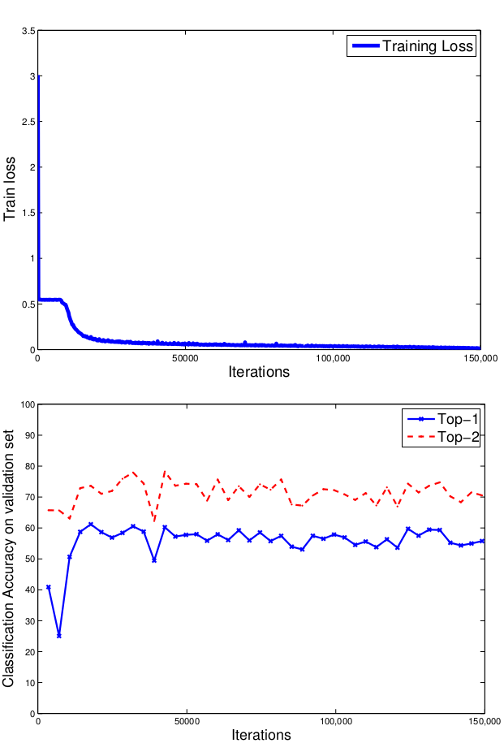
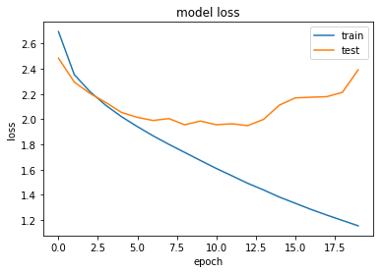
Training Results
val
The constant decrease in training loss.
The validation loss decreases initially, starts increasing after 13 epochs.
Amitojdeep Singh

Slide 20
Results on FER 2013
In paper (200 epochs)
Top-1 : 66.4%
Top-2 : 81.7%
Our implementation of paper (20 epochs)
Top-1 : 55.4%
Top-2 : 75.5%
Improvement made (20 epochs)
Top-1 : 61.5%
Top-2 : 77.8%
Amitojdeep Singh

Slide 21
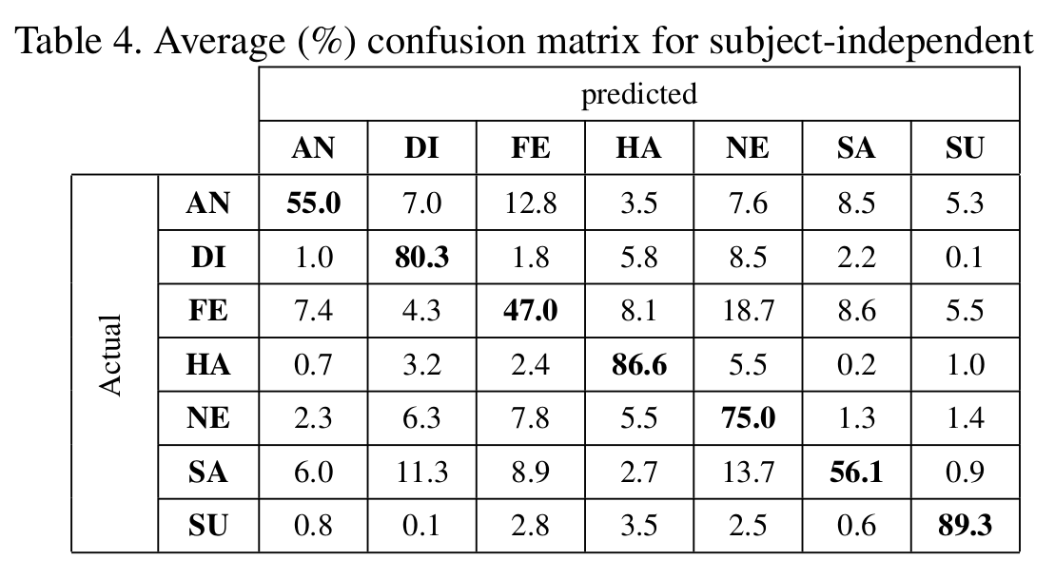
Confusion Matrix - Paper
Average on all datasets
Amitojdeep Singh

Slide 22
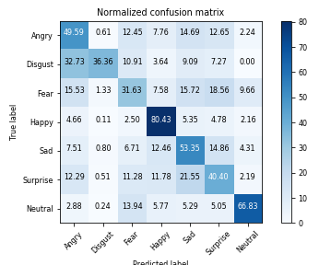
Our Implementation: 20 Epochs
Top 1 - 55.4%, Top 2 -75.5%
Amitojdeep Singh

Slide 23
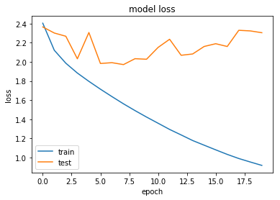
Improvisations
Training accuracy was growing more than validation - possible overfitting
Dropout:
Zero out p fraction of nodes randomly
Added dropout of 0.2 before dense layer
Batch normalization :
Normalizes activations
Faster learning with higher LR
Added after each inception block
Amitojdeep Singh

Slide 24
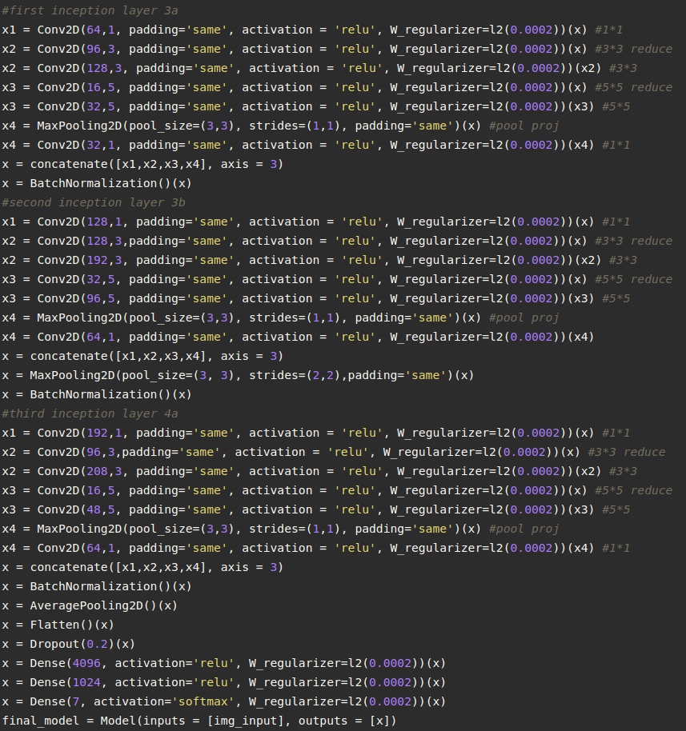

Slide 25
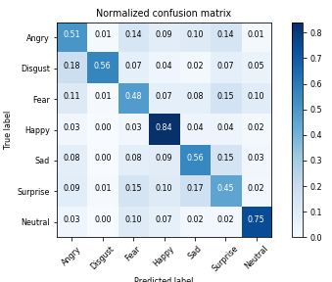
After improvisation(20 epochs)
Top 1 - 61.5%, Top 2: 77.5%
Before After
Amitojdeep Singh

Slide 26
Challenges Faced
Computational Constraints
30-40 minutes per epoch
Lower number of epochs
Non public databases
Some databases are paid, others too small
Performed on only 1 publicly available wild database(as required)
Amitojdeep Singh

Slide 27
Further Suggestions
Ensemble of models
Train multiple models
Take mode of predictions
Loss adapted for top 2 accuracy
Improved data augmentation: in progress

Slide 28
Thank You

